Slide 1
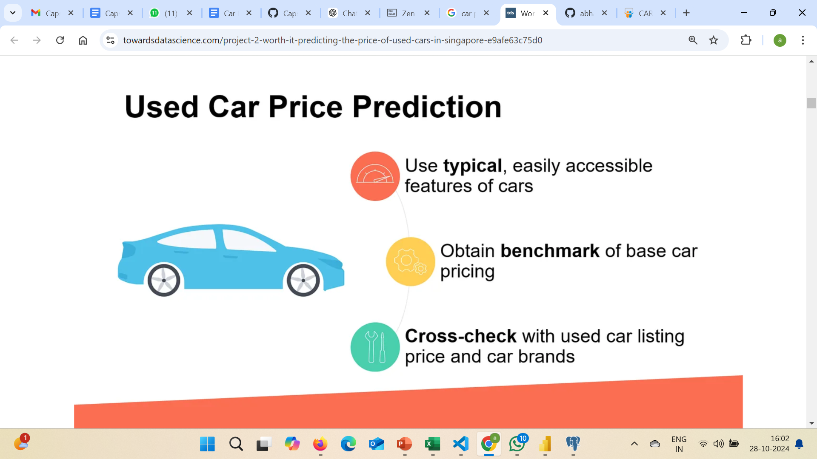
Predicting Car Prices using Machine Learning & Streamlit
Capstone Project – 3
By
Arangarajan Vinayagam

Slide 2
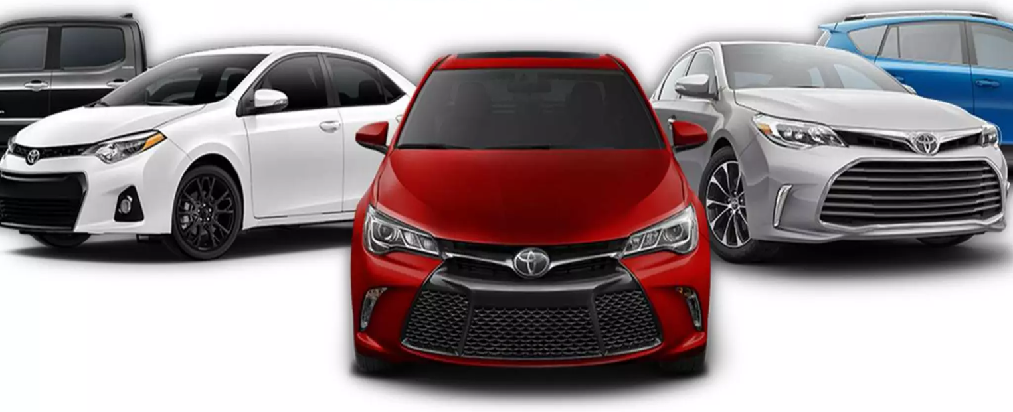
Objective
The main objective of this project is to develop a reliable, data-driven tool that predicts the resale price of used cars.
Using machine learning algorithms, this application can examine important car traits—including make, model, year, mileage, and more to produce accurate price predictions of used cars.
These estimations are beneficial to both consumers and dealerships, as they offer realistic market prices that can significantly improve decision-making.

Slide 3
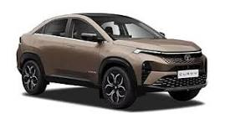
Overview
This project integrates machine learning capabilities with Streamlit, a powerful and intuitive web application framework, to produce an interactive, user-friendly platform.
Machine Learning Techniques:
• Predicts car prices using a machine learning model trained on historical car sales data.
• Uses algorithms like Linear Regression, Decision Tree, Random Forest, and Gradient Boosting Regressor to identify patterns and produce accurate predictions.
• Accounts for critical features affecting car prices, allowing generalization to various car types and conditions.
Streamlit Application:
• Enables deployment of the model in a web-based application.
• Provides an easy-to-use interface for user inputs.
• Instantly generates and displays price predictions for real-time interaction.

Slide 4
Data Processing
Data source:
The dataset used for this project is obtained from Car Dheko, a leading automotive website in India that provides data on car listings, including specifications, pricing, and other relevant information. The Excel dataset of cars from different city (Chennai, Bangalore, Hyderabad, Delhi, Kolkata, Jaipur) are in unstructured format (nested dictionary type).
Data Cleaning and Pre-Processing:
Step 1: Each city dataset is loaded and read with Pandas.
Step 2: Each column values in the Dataset (Chennai cars) is unnested:
Using “def parse_dict(x)” function to convert string representation of dictionary values into an actual dictionary
Using “ast.literal_eval(x)” function converts strings representing data structures into actual dataset, literal_eval only parses string containing python literals (like dictionaries, lists, tuples, numbers, strings, etc.) into corresponding python objects.
Applying “flatten function” on specific column to extract the key-value pairs (to get converter flat dictionary from the nested or unstructured data).
Function “pd.Series” applied to each row of the features column, converting each dictionary into multiple columns with corresponding keys and values.

Slide 5
Data Processing
Data Cleaning and Pre-Processing: (contd..)
Step 3: Removed unwanted columns which are not make much impacts on the target variable (Car Prices) and added new column with name of City (added Chennai)
Step 4: Data Frame with details of cars for Chennai city is created with name of “df_chenna1”
df_chennai1:
 | Fuel_Type | Body_Type | Km_Driven | Transmission | Ownership | Model | Model_Year | Price_Rupees | Engine_cc | MaxPower_bhp | Mileage_kmpl | City
0 | Petrol | SUV | 20,000 | Automatic | 1 | Kia Sonet | 2022 | ₹ 11.50 Lakh | 998 CC | 118.36bhp | NaN | Chennai
1 | Petrol | Minivans | 20,687 | Manual | 1 | Maruti Eeco | 2015 | ₹ 4.15 Lakh | 1196 CC | 73bhp | 15.37 kmpl | Chennai
2 | Petrol | SUV | 30,000 | Manual | 1 | Nissan Magnite | 2021 | ₹ 7.50 Lakh | 999 CC | 98.63bhp | 20 kmpl | Chennai
3 | Petrol | Hatchback | 59,247 | Manual | 1 | Hyundai i10 | 2015 | ₹ 3.98 Lakh | 1086 CC | 68.05bhp | 19.81 kmpl | Chennai
4 | Petrol | Hatchback | 50,000 | Manual | 1 | Honda Jazz | 2015 | ₹ 5.50 Lakh | 1199 CC | 88.7bhp | 18.7 kmpl | Chenna

Slide 6
Data Processing
Data Cleaning and Pre-Processing: (contd..)
Step 5: Repeating steps 1 to 4, and created Data Frame for other cities with respective names as follows: df_bangalore1, df_hyderabad1, df_delhi1, df_Kolkata1, and df_jaipur1.
Step 6: Merge all the data frames and make it single data Frame named as df_combined1
df_combined1: (12 columns X 8368 rows)
 | Fuel_Type | Body_Type | Km_Driven | Transmission | Ownership | Model | Model_Year | Price_Rupees | Engine_cc | MaxPower_bhp | Mileage_kmpl | City
8364 | Diesel | SUV | 1,56,039 | Manual | 2 | Toyota Fortuner | 2012 | ₹ 16.49 Lakh | 2982 CC | 168.5bhp | 12.55 kmpl | Bangalore
8365 | Petrol | Sedan | 56,000 | Manual | 2 | Maruti SX4 | 2008 | ₹ 3.30 Lakh | 1586 CC | 104.68 | 15 kmpl | Bangalore
8366 | Petrol | Hatchback | 42,000 | Manual | 2 | Honda Brio | 2014 | ₹ 4.25 Lakh | 1198 CC | 86.8bhp | 19.4 kmpl | Bangalore
8367 | Diesel | Hatchback | 93,003 | Manual | 1 | Hyundai i20 | 2018 | ₹ 7.50 Lakh | 1396 CC | 88.73bhp | 22.54 kmpl | Bangalore
8368 | Petrol | Hatchback | 36,000 | Automatic | 2 | Hyundai Grand i10 | 2017 | ₹ 6.75 Lakh | 1197 CC | 82bhp | 18.9 kmpl | Bangalore

Slide 7
Data Processing
Data Cleaning and Pre-Processing: (contd..)
Step 7: Identify the null/missing values from the “df_combined” data frame
df_combined1.isnull().sum()
Step 8: Removed null or invalid entry in the df_combined1 data frame for the Mileage_kmpl, Enginee_cc, MaxPower_bhp column values
df_combined1['Mileage_kmpl'].fillna(df_combined1['Mileage_kmpl'].mode()[0], inplace=True)
df_combined1['Engine_cc'].fillna(df_combined1['Engine_cc'].mode()[0], inplace=True)
df_combined1['MaxPower_bhp'].fillna(df_combined1['MaxPower_bhp'].mode()[0], inplace=True)
df_combined1.isnull().sum()
Fuel_Type | 0
Body_Type | 0
Km_Driven | 0
Transmission | 0
Ownership | 0
Model | 0
Model_Year | 0
Price_Rupees | 0
Mileage_kmpl | 267
Engine_cc | 4
MaxPower_bhp | 60
City | 0
dtype: int64
Fuel_Type | 0
Body_Type | 0
Km_Driven | 0
Transmission | 0
Ownership | 0
Model | 0
Model_Year | 0
Price_Rupees | 0
Mileage_kmpl | 0
Engine_cc | 0
MaxPower_bhp | 0
City | 0
dtype: int64 | 0

Slide 8
Data Processing
Data Cleaning and Pre-Processing: (contd..)
Step 9: Make standardized data format:
Column 'Km_Driven’ (convert into string, remove commas, and convert back to int),
Column ‘Prices’ (Remove '₹', 'Lakh', 'Crore', and any commas and convert into float),
Column ‘Mileage’ (remove 'kmpl' or 'km/kg' and convert to float),
Column ‘Engine’ (remove 'CC' and convert to integer),
Column ‘MaxPower’ (remove ‘bhp’ and ‘ps’ and convert to float)
Step 10: Encoding categorical Variables:
Using one hot and label encoding methods, the categorical variables (Fuel_Type', 'Body_Type', 'Transmission', 'City’, 'Ownership’) are encoded.
Step 11: normalization of numerical features:
Using standard scaler from sklearn, normalization of numerical features (Km_Driven, Price_Rupees, Mileage_kmpl, Engine_cc, MaxPower_bhp) is carried out.

Slide 9
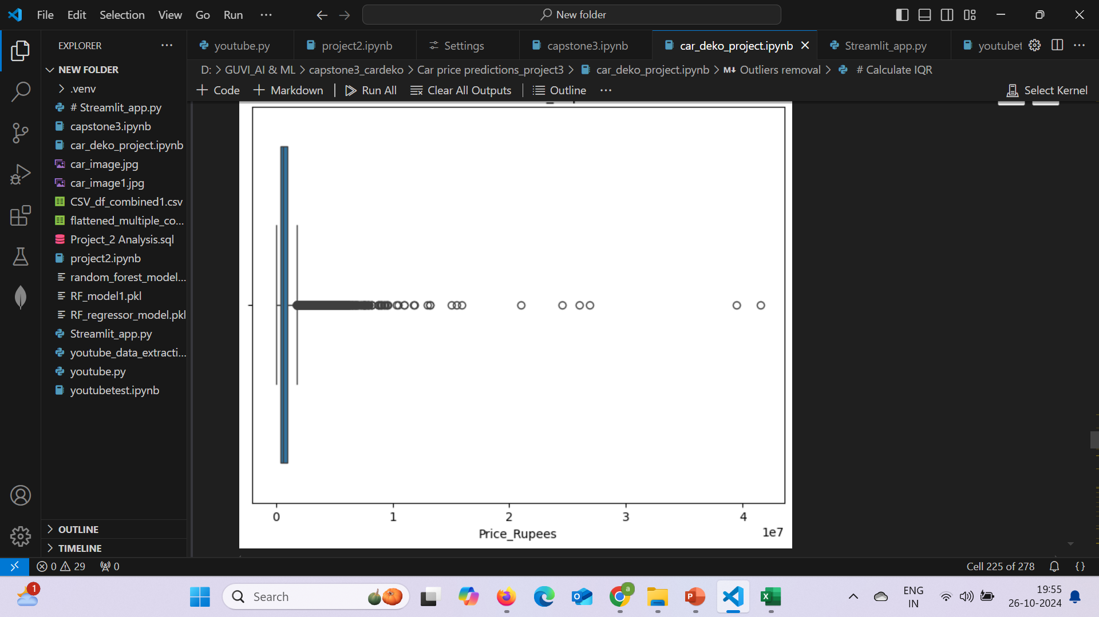
Data Processing
Data Cleaning and Pre-Processing: (contd..)
Step 12: Removal of outliers:
For the target variable ‘price_rupees’, created box plot to visualize the outlier points
Applied IQR method, estimated and removed min and max outliers (Lower Bound: -425000.0, Upper Bound: 1775000.0)
Q1 = df_encoded4['Price_Rupees'].quantile(0.25)
Q3 = df_encoded4['Price_Rupees'].quantile(0.75)
IQR = Q3 - Q1
lower_bound = Q1 - 1.5 * IQR
upper_bound = Q3 + 1.5 * IQR
Box Plot of Price_rupees

Slide 10
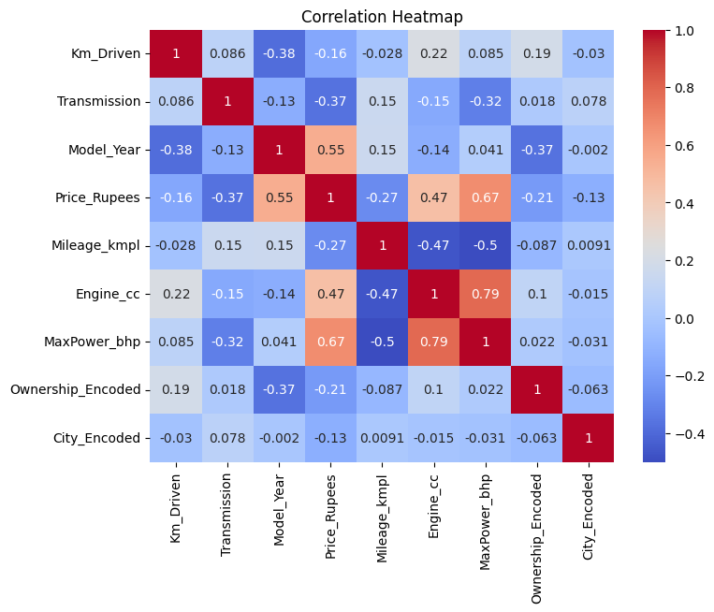
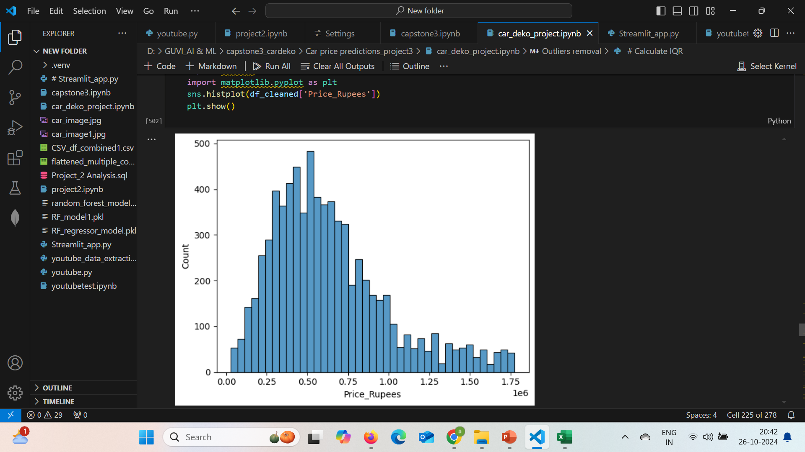
Exploratory Data Analysis (EDA)
Step 1: Descriptive Statistics: Statistic analysis carried out to know the distribution of data.
Step 2: The patterns and correlation among features are identified through visualizations by histograms and correlation heatmaps.

Slide 11
Model Development & Results of Metrics
Step 1: Selection of features and assign X and y for input features and Target respectively.
Step 2: Train and Test split features 80:20
Step 3: Import the Linear Regression model (LR_model)
Step 4: Train the model (X-train, y-Train)
Step 5: y-Prediction (X-test)
Step 6: Evaluate the model performance in terms of MAE, MSE, and R-square
Step 7: Import the Decision Tree Regressor (DT_model)
Step 8: To get predictions and evaluate DT_model performance repeat the steps 4 to 6
Mean Absolute Error (MAE): 118126.97
Mean Squared Error (MSE): 25817469185.20
R-squared (R²): 0.7913
Mean Absolute Error (MAE): 91754.89
Mean Squared Error (MSE): 21767094604.03
R-squared (R²): 0.8240

Slide 12
Model Development and Results of Metrics
Step 9: Import the Random Forest Regressor (RF_model)
Step 10: To get predictions and evaluate RF_model performance repeat the steps 4 to 6
Step 11: Import the Gradient Boosting Regressor (GB_model)
Step 12: To get predictions and evaluate GB_model performance repeat the steps 4 to 6
Mean Absolute Error (MAE): 70057.08
Mean Squared Error (MSE): 11277480252.21
R-squared (R²): 0.9088
Mean Absolute Error (MAE): 80421.78
Mean Squared Error (MSE): 12838451395.85
R-squared (R²): 0.8962
Step 13: Comparative analysis is carried out to find the best model
In Comparative results of metrics among models, RF_model provides better performance than others.
 | MAE | MSE | R²
LR_model | 118126.97 | 25817469185.20 | 0.791
DT_model | 91754.89 | 21767094604.03 | 0.824
RF_model | 70057.08 | 11277480252.21 | 0.909
GB_model | 80421.78 | 12838451395.85 | 0.896

Slide 13
Model Development and Results of Metrics
Step 14: Hyper Parameters tuning with DT model
Using Grid Search technique, the main hyperparameters (max_depth, min_samples_split, min_samples_leaf) are tuned.
Assign ranges for each parameters: pa= {
'max_depth': [3, 5, 10, 20],
'min_samples_split': [2, 5, 10],
'min_samples_leaf': [1, 2, 4]
Obtain best hyperparameters: ({'max_depth': 20, 'min_samples_leaf': 4, 'min_samples_split': 2})
Evaluate the results of MSE and R²
Step 15: Hyper Parameters tuning with RF model
Using Random Search technique, the main hyperparameters (n_estimators, max_depth, min_samples_split, min_samples_leaf) are tuned.
Assign ranges for each parameters:
'n_estimators': [50, 100, 200],
'max_depth': [None, 10, 20, 30],
'min_samples_split': [2, 5, 10],
'min_samples_leaf': [1, 2, 4]
Obtain best hyperparameters: {'n_estimators': 200, 'min_samples_split': 2, 'min_samples_leaf': 1, 'max_depth': 30}
Evaluate the results of MSE and R²
MSE: | 18624859699.82
R² | 0.8494
MSE: | 11247912540.41
R² | 0.909

Slide 14
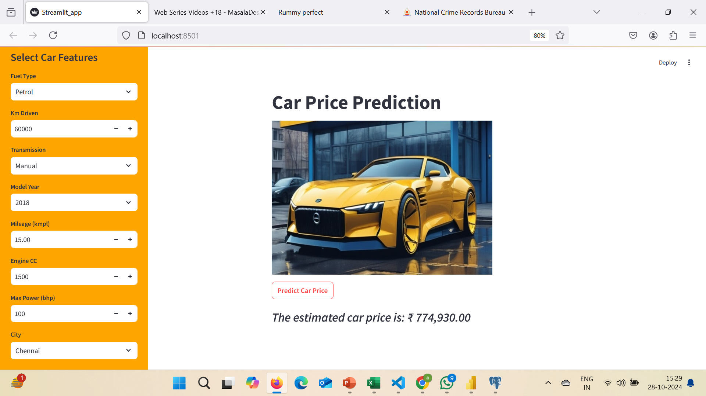
Model Deployment with Streamlit Application
Step 1: Train the RF model with assigned features of X (Fuel_Type, Km_Driven, Transmission, Model_Year, Mileage_kmpl, Engine_cc, MaxPower_bhp, City) and y (Price_Rupees)
Step 2: Trained RF model is saved as ‘random_forest_model.pkl’
Step 3: Create a file “Streamlit_app.py” with following steps:
Import libraries (streamlit, numpy, picle, joblib)
Load the RF model file ‘random_forest_model.pkl’
Create Title of page with import of car images
Configure side bar with user inputs of car features
Map categorical features to numeric values
Normalize the numeric inputs
Create an array for input features
Create prediction button as output

Slide 15
Model Deployment with Streamlit Application
Step 4: In Terminal, give command, as “streamlit run Streamlit_app.py”
Streamlit application open on new web page
The streamlit web appears with provision of user input features and output prediction.
User can input relevant input features and get appropriate predictions in car prices.

Slide 16
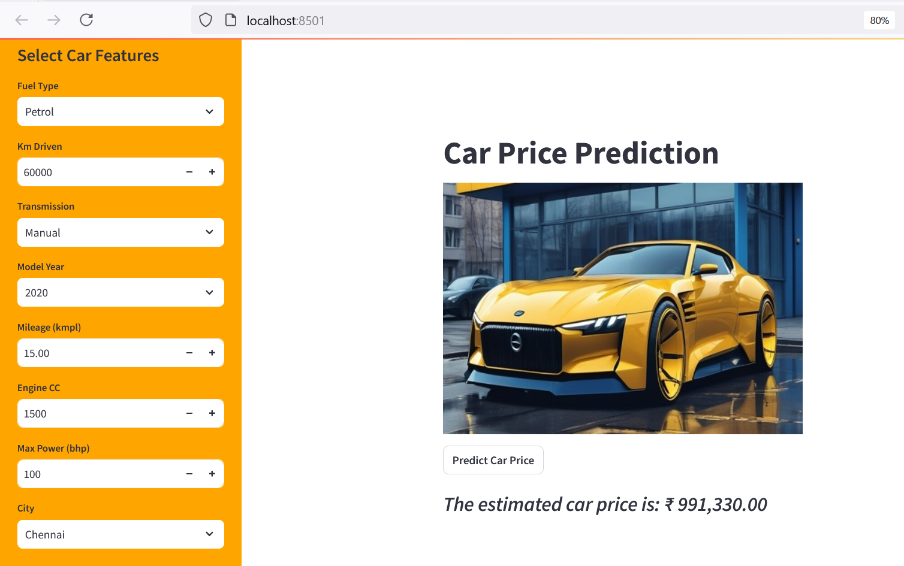
Model Deployment with Streamlit Application

Slide 17
Thank You

